Slide 1
‘In a canter’? Demystifying Australia’s Emissions Budget for Paris Australian-German Climate and Energy College (22nd Feb 2019)
Tim Baxter Fellow—Melbourne Law School, University of Melbourne Associate—Australian-German Climate and Energy College

Slide 2
Got questions?
URL: slido.com
Event code: #canter
Previous slide image credit: CSIRO (CC-BY 3.0) Background image credit: David Iliff (CC-BY-SA 3.0)

Slide 3
A quick note
Charts used in the presentation are simplified, with minor adjustments to give an accurate reflection of the targets relative to 2018 emissions estimates
(And keep your eye on my y-axes)
Previous slide image credit: CSIRO (CC-BY 3.0) Background image credit: David Iliff (CC-BY-SA 3.0)

Slide 4
The commitment periods
Australia’s three commitments under the UNFCCC
The first (‘Kyoto CP1’) target was negotiated at the Kyoto Conference of the parties in 1997
Bound only countries that were members of the OECD at the time *Wrapped up in 2015*
The second (‘Kyoto CP2’) target was pledged by Australia at Copenhagen in 2009, but only became a true commitment at Doha in 2012
Only bound members who were bound under Kyoto CP1 and who elected to be bound again *Binding, but not yet in force*
The third (‘Paris’) was submitted as part of the Paris INDC process in 2015.
Submitting an NDC is mandatory, meeting it is not. *Strictly non-binding, but in force*
Kyoto CP1 | 2008–2012 inclusive | +8% on 1990 levels over 2008 – 2012
Kyoto CP2 | 2013–2020 inclusive | -5% on 2000 levels by 2020
Paris | 2021–2030 inclusive | -26%–28% on 2005 levels by 2030
Questions? URL: slido.com; Code: #canter

Slide 5
QELROs versus trajectories
All Australian targets are a budget, but there are many ways to calculate that budget
Under Kyoto CP1 (and, strictly, under Kyoto CP2), Australia’s targets are calculated using a QELRO/QELRC approach
A flat line between start and finish set at the promised level
The government has shifted to using trajectories for Kyoto CP2 and Paris
A linear trajectory between a start point (usu, the finish of the previous period) and the target point
It is never just an endpoint target
Questions? URL: slido.com; Code: #canter

Slide 6
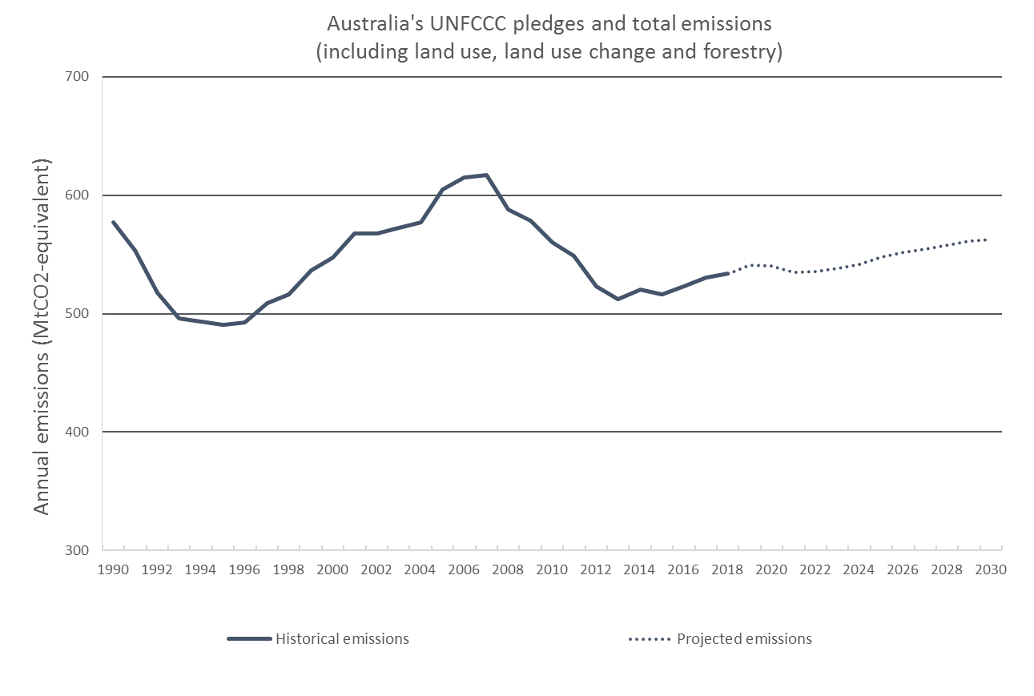
Australia’s emissions under the three periods
Our emissions since 1990 have been relatively stable
Historic trend is very slight growth each year
This is expected to continue out to 2030
The charts that follow are simplified slightly
To calculate this correctly, you would need multiple lines of historic emissions
(All data from DoEE’s Australia’s Emissions Projections (2018))
‘Demystifying Australia’s Emissions Budgets for Paris’ – Tim Baxter – 22nd Feb 2019
Questions? URL: slido.com; Code: #canter

Slide 7
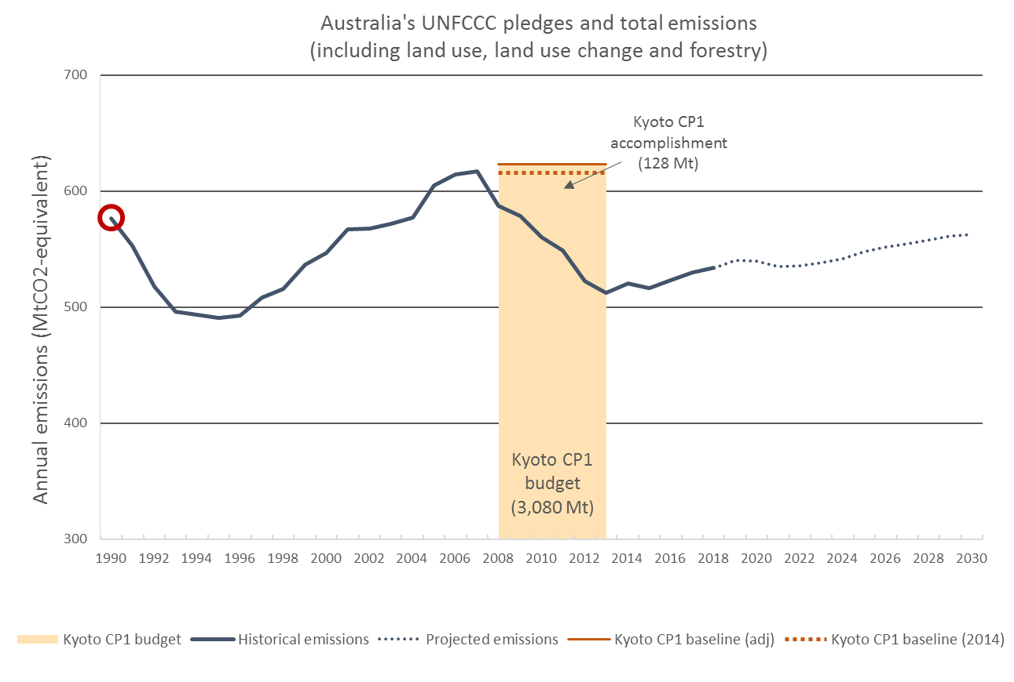
Australia’s emissions under the three periods
Kyoto CP1 target: +8% on 1990 levels over the period 2008–2012 inclusive
Australia’s emissions never got close
Drop in this period mostly GFC
ALP’s CPM can’t explain the downward trend
We beat that target by 128Mt
* CP1 baseline redrawn in its position relative to 2006 emissions
*
‘Demystifying Australia’s Emissions Budgets for Paris’ – Tim Baxter – 22nd Feb 2019
Questions? URL: slido.com; Code: #canter

Slide 8
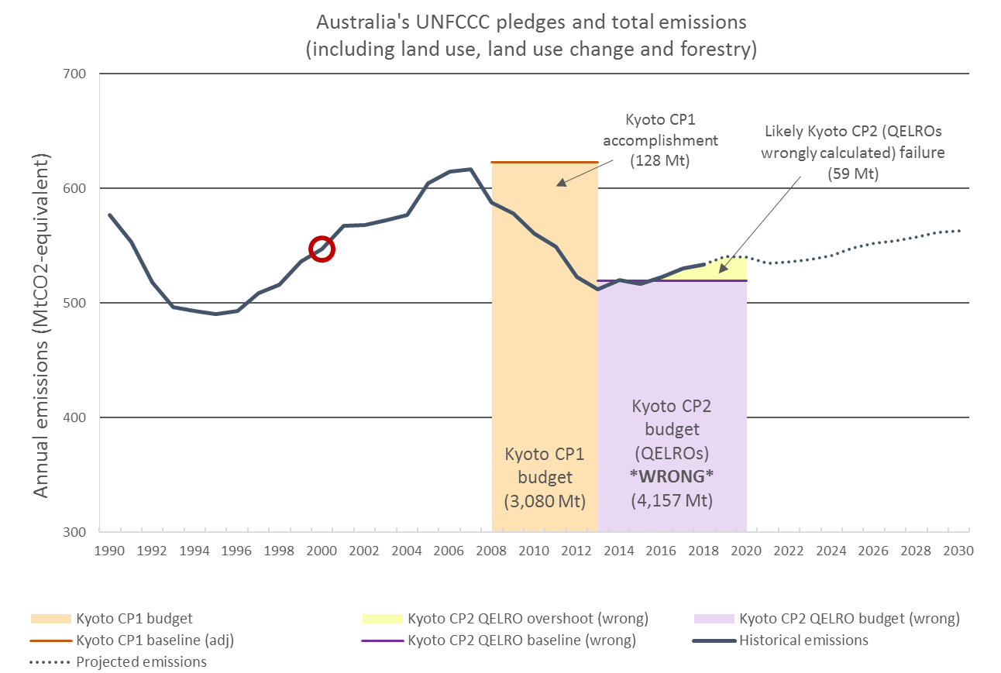
Australia’s emissions under the three periods
Kyoto CP2 target:-5% on 2000 levels over 2013–2020
If that was the end of the story, we would be expected to blow our budget by 59Mt
It isn’t…
This is wrong. Don’t do this.
‘Demystifying Australia’s Emissions Budgets for Paris’ – Tim Baxter – 22nd Feb 2019
Questions? URL: slido.com; Code: #canter

Slide 9
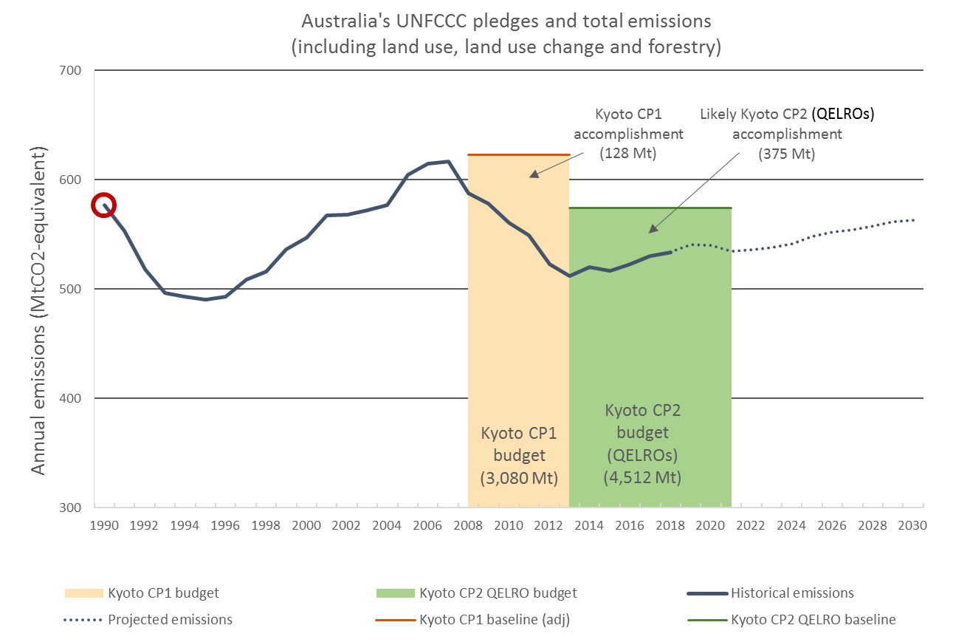
Australia’s emissions under the three periods
Technically, our commitment to the international community is a -0.5% on 1990 levels over 2013–2020
We are likely to beat that by 375Mt
In its communication of the target domestically, Australia doesn’t use this, but it is the actual target
‘Demystifying Australia’s Emissions Budgets for Paris’ – Tim Baxter – 22nd Feb 2019
Questions? URL: slido.com; Code: #canter

Slide 10
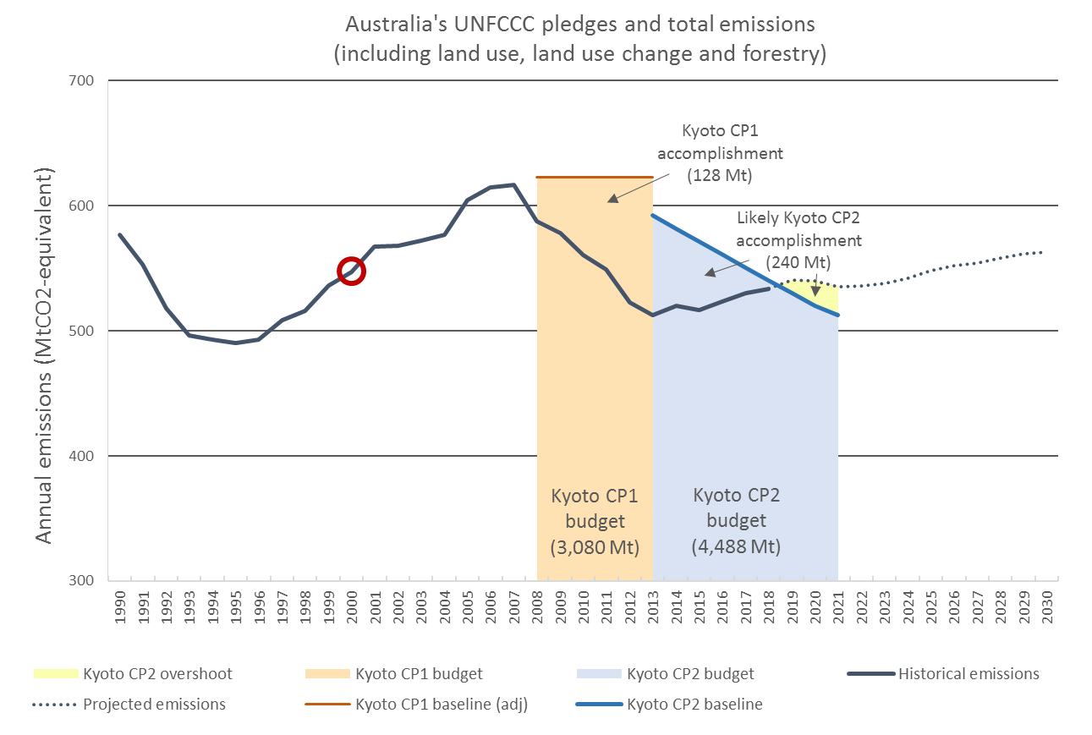
Australia’s emissions under the three periods
Australia has recently taken to calculating its target differently
Trajectory is a straight line drawn from +8% on 1990 in 2010 to -5% on 2000 levels in 2020
Total accomplishment includes 261 Mt surplus and 31 Mt excess
Put in terms of Kyoto CP1, this target is -3.6% on 1990
The Doha Amendment is not in force, requiring 144 parties to the UNFCCC to indicate their acceptance (KP, art 20)
With two years to go, only 124 parties have done this
‘Demystifying Australia’s Emissions Budgets for Paris’ – Tim Baxter – 22nd Feb 2019
Questions? URL: slido.com; Code: #canter

Slide 11
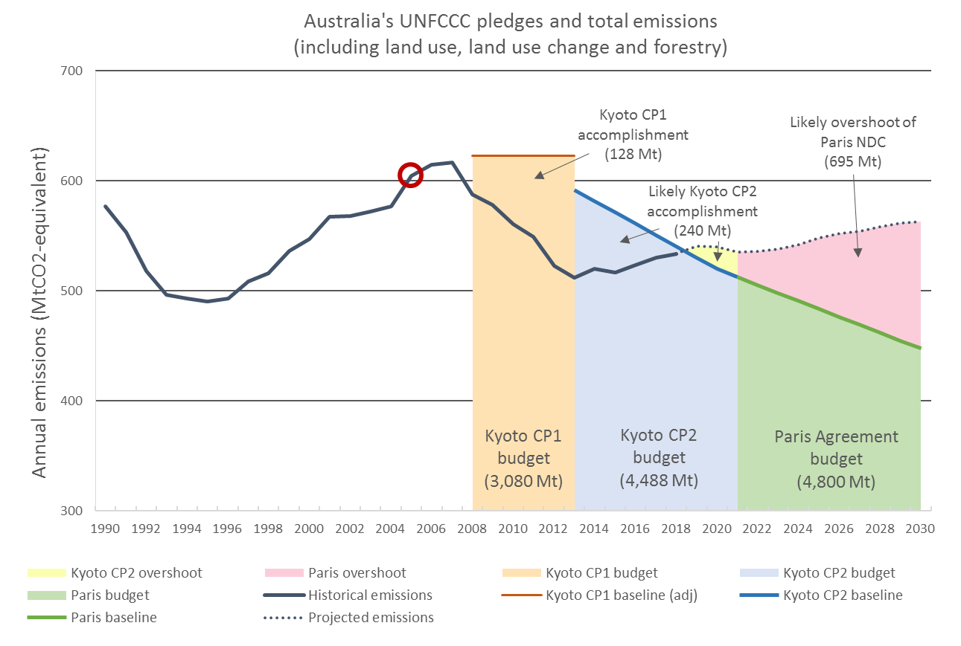
Australia’s emissions under the three periods
Paris trajectory drawn from end of Kyoto CP2 to -26% on 2005 levels in 2030
‘-26% on 2005 levels’ is -9% below 2011–2020 average
Currently, with all policies considered, we miss it by ~700Mt
Definitely NOT ‘in a canter’ on the government’s baseline scenario
Put in terms of Kyoto CP1 this target is -16.7% on 1990
‘Demystifying Australia’s Emissions Budgets for Paris’ – Tim Baxter – 22nd Feb 2019
Questions? URL: slido.com; Code: #canter

Slide 12
‘Demystifying Australia’s Emissions Budgets for Paris’ – Tim Baxter – 22nd Feb 2019
Questions? URL: slido.com; Code: #canter

Slide 13
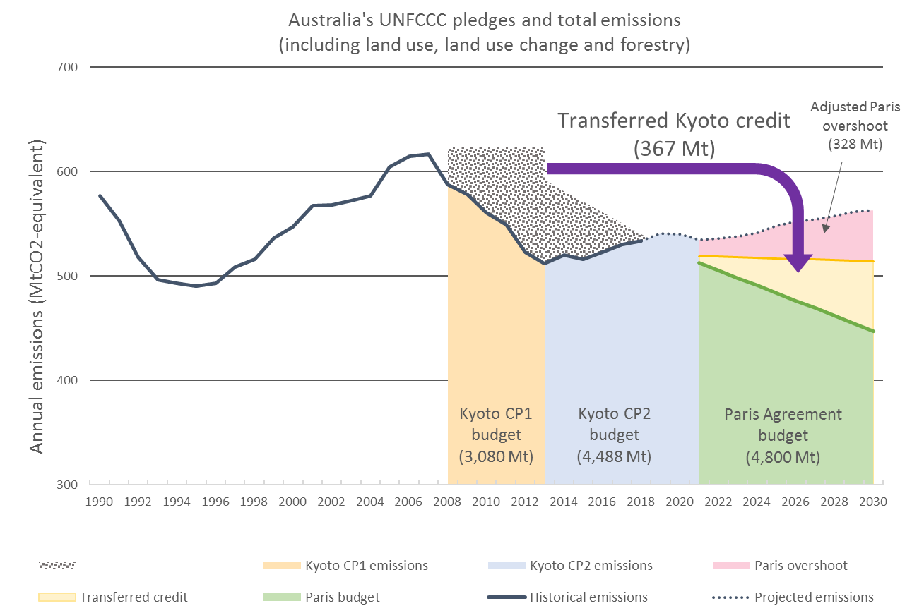
Australia’s emissions under the three periods
Under the most recent projections, the Gov’t started counting credit from previous periods against Paris
This should not be an option
If permitted, our de facto Paris target goes from being among the worst in the developed world to the worst in the developed world
‘Demystifying Australia’s Emissions Budgets for Paris’ – Tim Baxter – 22nd Feb 2019
Questions? URL: slido.com; Code: #canter

Slide 14
Australia’s emissions:
A LULUCF story
‘Demystifying Australia’s Emissions Budgets for Paris’ – Tim Baxter – 22nd Feb 2019
Background image credit: NASA/JPL

Slide 15
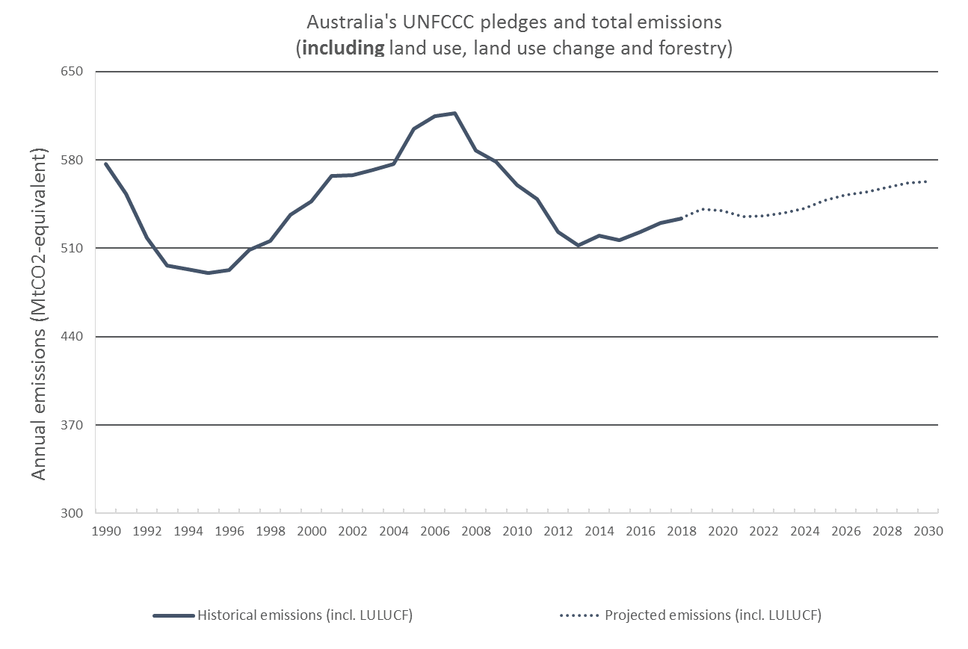
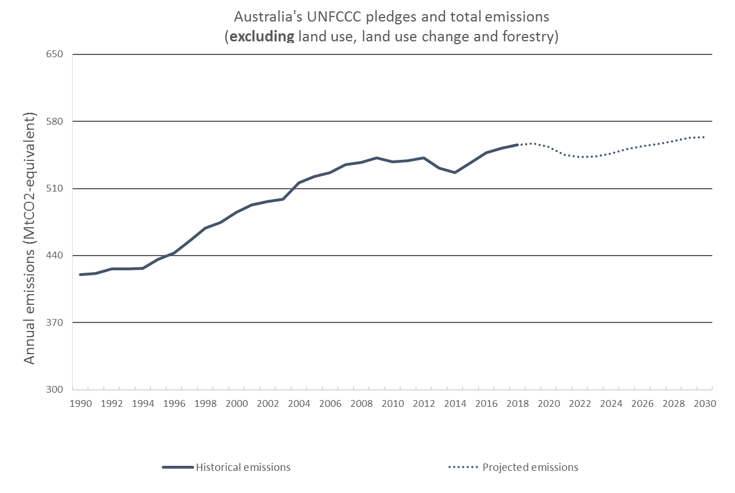
Australia’s emissions: A LULUCF story
To get a better sense of Australia’s emissions, it is worthwhile looking at our emissions excluding LULUCF
There you can see, for the first time, the impact of the GFC versus the impact of the carbon price
Carbon price, at most, can claim 25Mt of reductions
Only six out of 28 years not all-time records (2010–2015)
‘Demystifying Australia’s Emissions Budgets for Paris’ – Tim Baxter – 22nd Feb 2019
Questions? URL: slido.com; Code: #canter

Slide 16
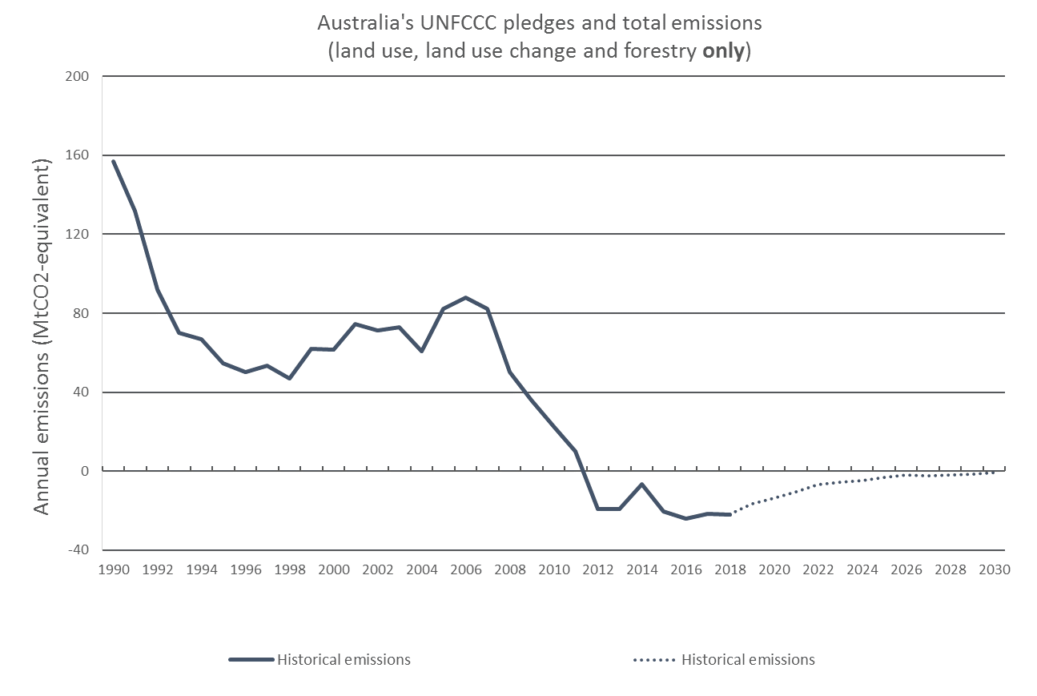
Australia’s emissions: A LULUCF story
Two big dips
One in Hawke-era
One post-GFC
Revisions to the LULUCF calculations made in 2015 increased the sway that LULUCF has on our national accounts
Makes our past emissions look worse, present better
Recent data (approx. <5 years) unreliable
‘Demystifying Australia’s Emissions Budgets for Paris’ – Tim Baxter – 22nd Feb 2019
Questions? URL: slido.com; Code: #canter

Slide 17
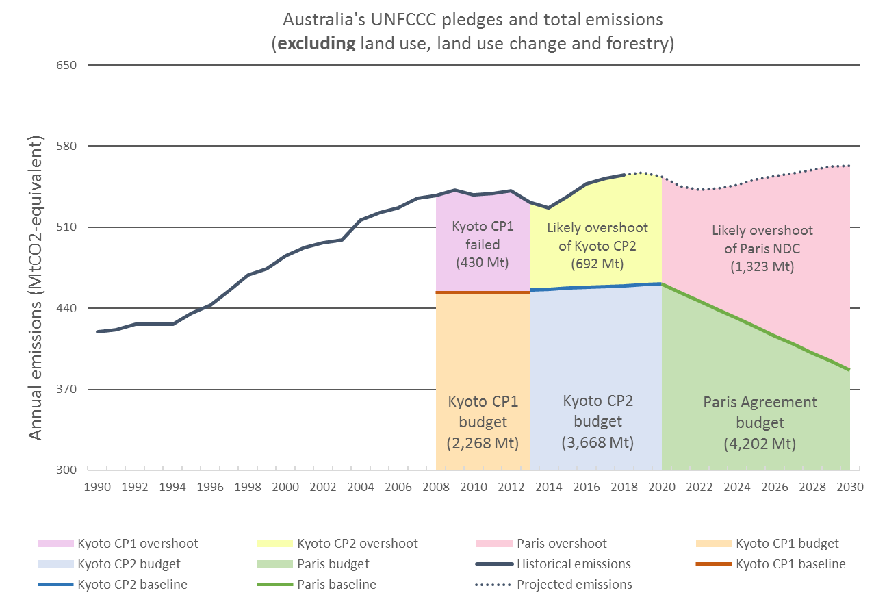
Australia’s emissions: A LULUCF story
Without LULUCF, we would have failed Kyoto CP1, cannot possibly meet Kyoto CP2 and are on track to miss Paris by twice as much
‘Demystifying Australia’s Emissions Budgets for Paris’ – Tim Baxter – 22nd Feb 2019
Questions? URL: slido.com; Code: #canter

Slide 18
Large Image Slide
A whirlwind tour through Australia’s sectoral emissions
‘Demystifying Australia’s Emissions Budgets for Paris’ – Tim Baxter – 22nd Feb 2019
Questions? URL: slido.com; Code: #canter

Slide 19
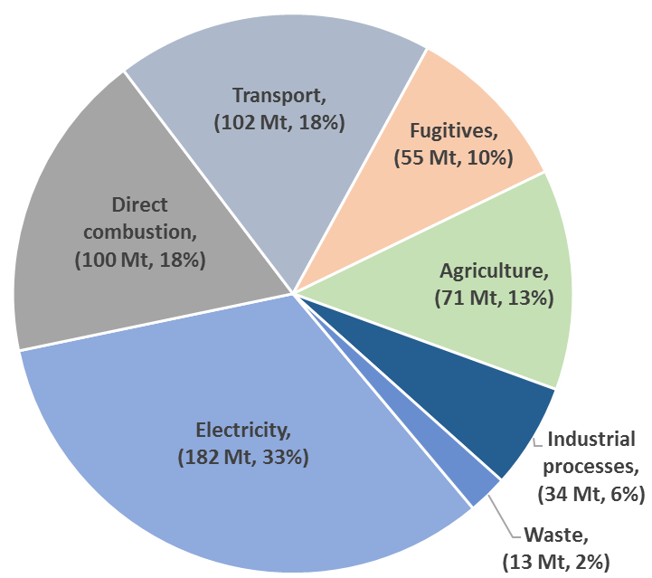
Australia’s emissions profile
As of 2018 LULUCF (-4%)
‘Demystifying Australia’s Emissions Budgets for Paris’ – Tim Baxter – 22nd Feb 2019
Background image credit: Swathi Sridharan (CC-BY-SA 2.0)

Slide 20
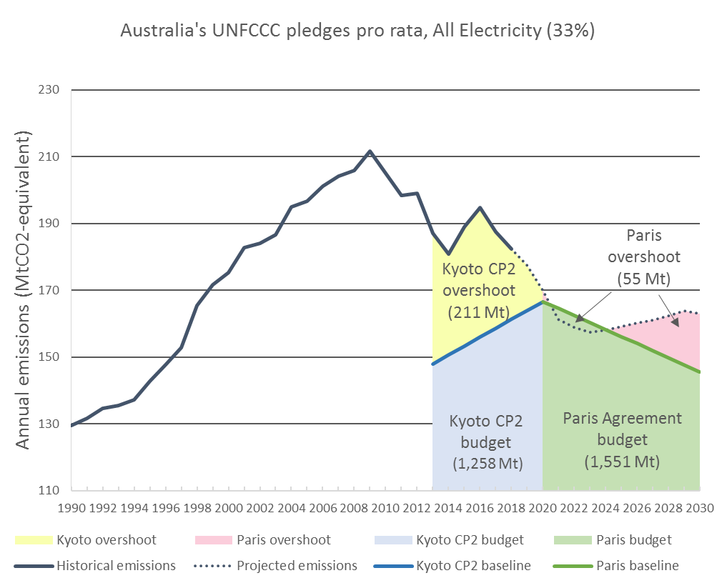
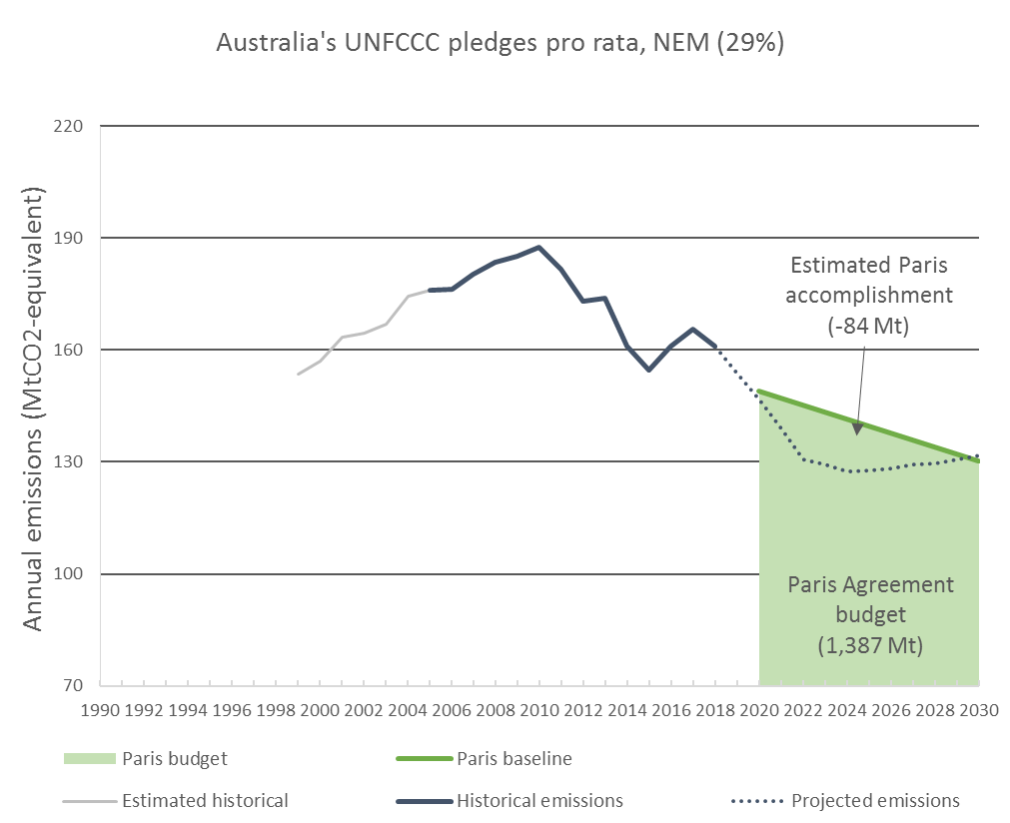
Australia’s sectoral emissions
Opportunities abound…
‘Demystifying Australia’s Emissions Budgets for Paris’ – Tim Baxter – 22nd Feb 2019
Questions? URL: slido.com; Code: #canter

Slide 21
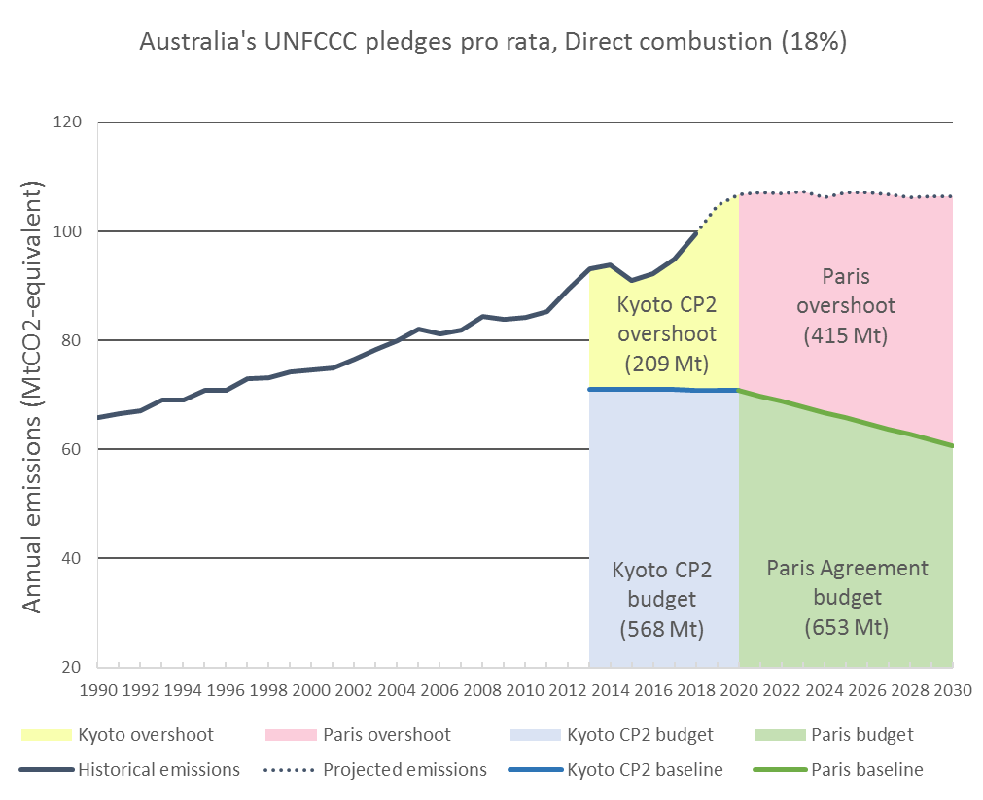
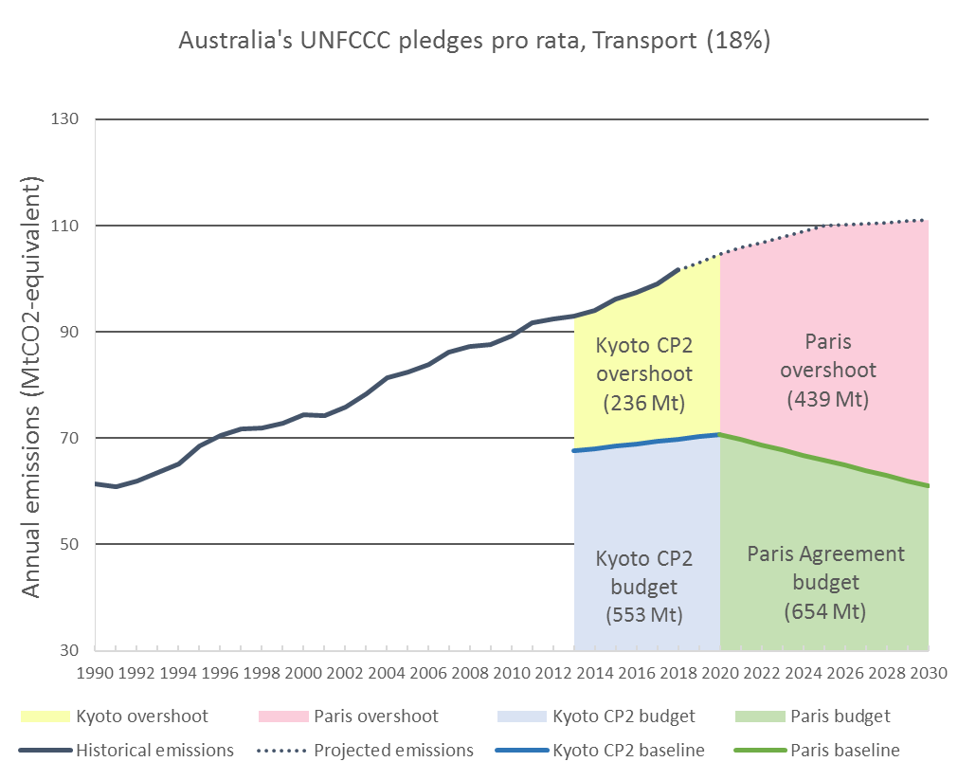
Australia’s sectoral emissions
Opportunities abound…
‘Demystifying Australia’s Emissions Budgets for Paris’ – Tim Baxter – 22nd Feb 2019
Questions? URL: slido.com; Code: #canter

Slide 22
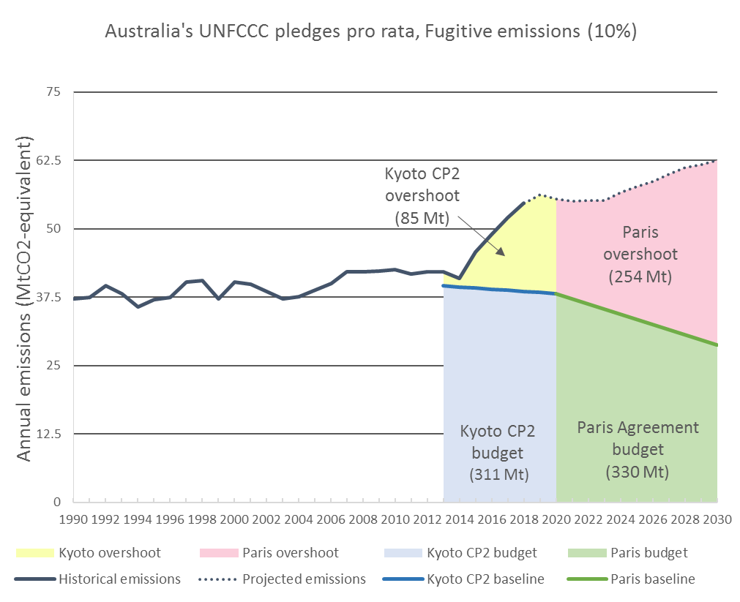
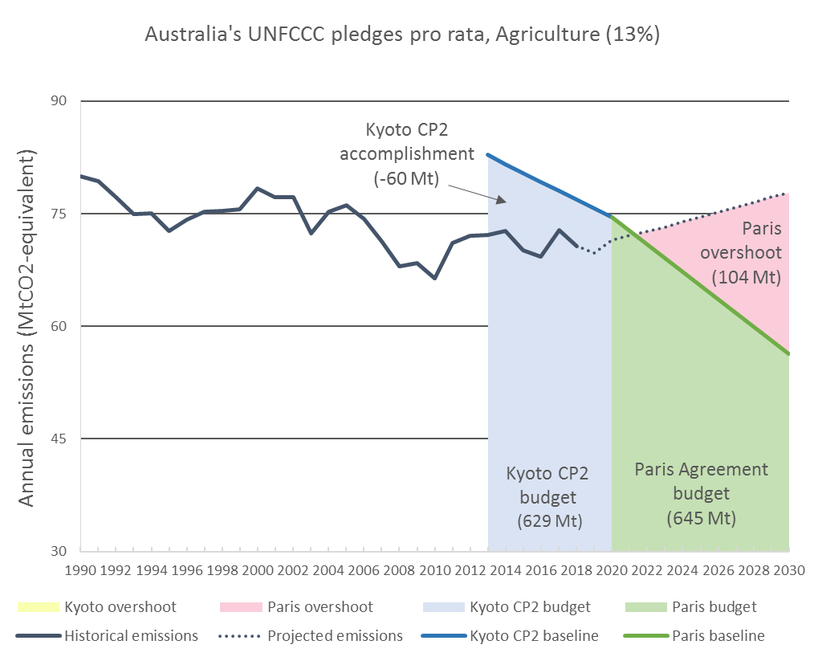
Australia’s sectoral emissions
Opportunities abound…
‘Demystifying Australia’s Emissions Budgets for Paris’ – Tim Baxter – 22nd Feb 2019
Questions? URL: slido.com; Code: #canter

Slide 23
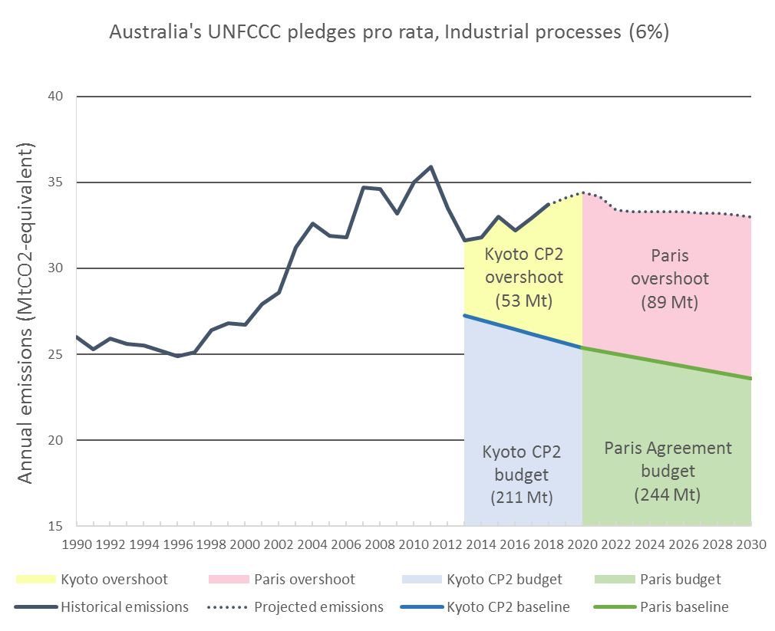
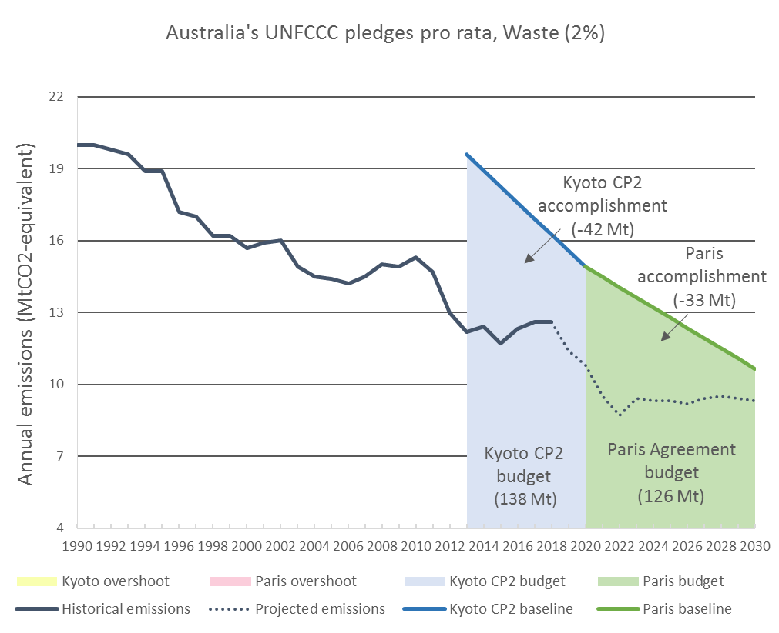
Australia’s sectoral emissions
Opportunities abound…
‘Demystifying Australia’s Emissions Budgets for Paris’ – Tim Baxter – 22nd Feb 2019
Questions? URL: slido.com; Code: #canter

Slide 24
Large Image Slide
ALP policy
‘Demystifying Australia’s Emissions Budgets for Paris’ – Tim Baxter – 22nd Feb 2019
Questions? URL: slido.com; Code: #canter

Slide 25
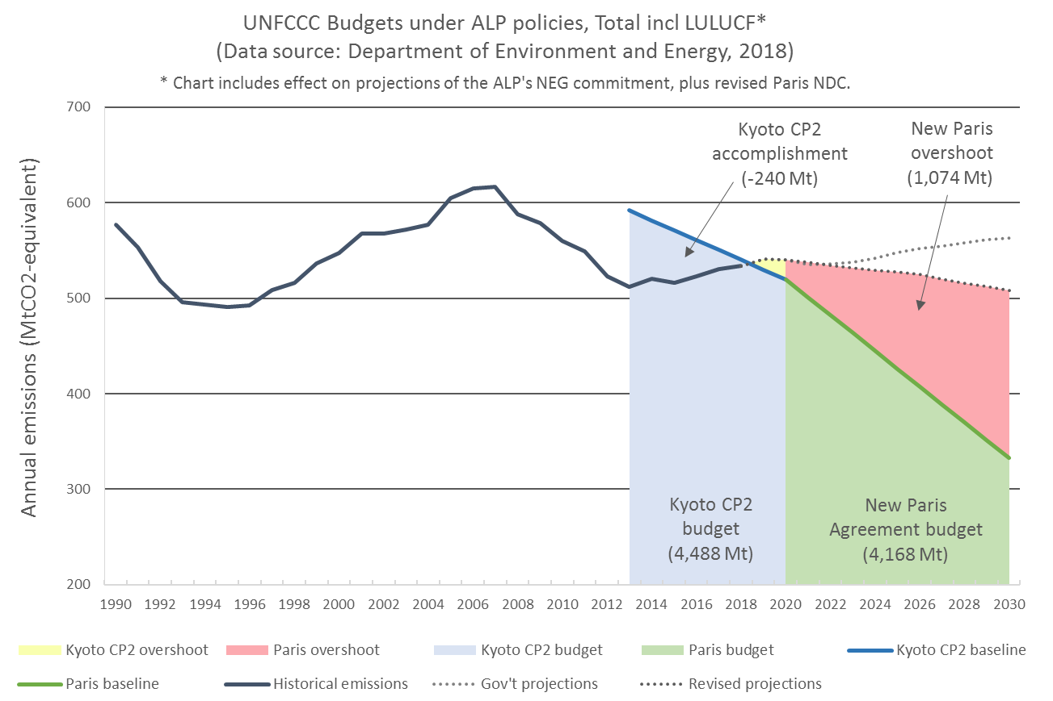
ALP policies
Taking into account only those policies that can be quantified, and adjusting for the ALP’s revised NDC, the policies produce a larger shortfall
However, this is not representative given many ALP policies lack detail or are difficult to quantify
For instance:
Safeguard 2.0 could greatly reduce projected emissions, but there is not enough detail
CEFC funding not quantifiable
These will likely affect emissions
‘Demystifying Australia’s Emissions Budgets for Paris’ – Tim Baxter – 22nd Feb 2019
Questions? URL: slido.com; Code: #canter
25

Slide 26
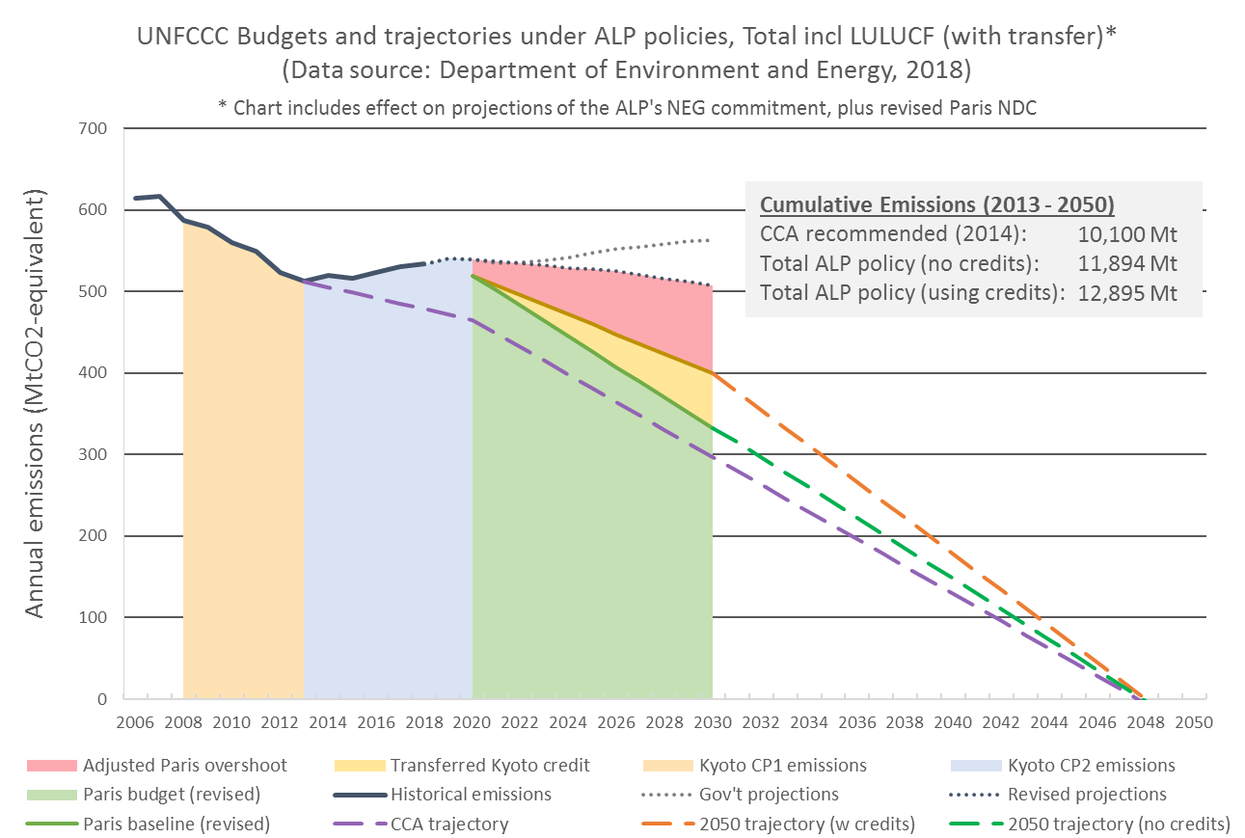
ALP policies
Their target does not comply with the advice of the Climate Change Authority in 2014:
Min -40% on 2000 levels by 2030
ALP target nearly meets this (-39.2% on 2000)
Total budget of 10,100 Mt 2013-2050
ALP target does not meet this if the trajectory continues (+847Mt post-2020)
ALP will need to rachet up its ambition beyond this target trajectory
‘Demystifying Australia’s Emissions Budgets for Paris’ – Tim Baxter – 22nd Feb 2019
Questions? URL: slido.com; Code: #canter
26

Slide 27
Australia’s climate targets are not strong, but we will not meet them at present
Current approach to target setting is one of systematic pessimism
Historically, Australia’s natural advantages have been squandered by governments of all stripes
Both L/NP and ALP versions of the climate target could easily be met
e.g. 40% reduction in emissions intensity of light vehicles—bringing us to USA’s efficiency standards—would avoid 59 Mt at a net saving of up to $350/tonne on fuel alone (CCA, 2014; ClimateWorks, 2014)
This relative lack of ambition is common, but not inevitable, and not compliant with a +1.5°C or +2°C
Questions? URL: slido.com
Code: #canter
‘Demystifying Australia’s Emissions Budgets for Paris’ – Tim Baxter – 22nd Feb 2019

Slide 28
Vanessa Petrie – Repowering our regions (with BZE) 4 March (6:30pm-8:00pm) @ Fritz Lowe Theatre
Prof Ian Young – The global ocean wind and wave climate: how it is changing and projections for 2100 6 March (2:00pm-3:00pm) @ College
Prof Myles Allen – Achieving Net Zero: Solving climate change without carbon taxes and with a little help of the fossil fuel industry 15 March (4:00pm-5:00pm) @ Lowe Theatre
Assoc Prof Malte Meinshausen and Tom Yankos – Climate and Carbon Challenges 11 April (5:30pm-7:00pm) @ Engineers Australia
Upcoming college events
(Register through our website)

